Slide 1
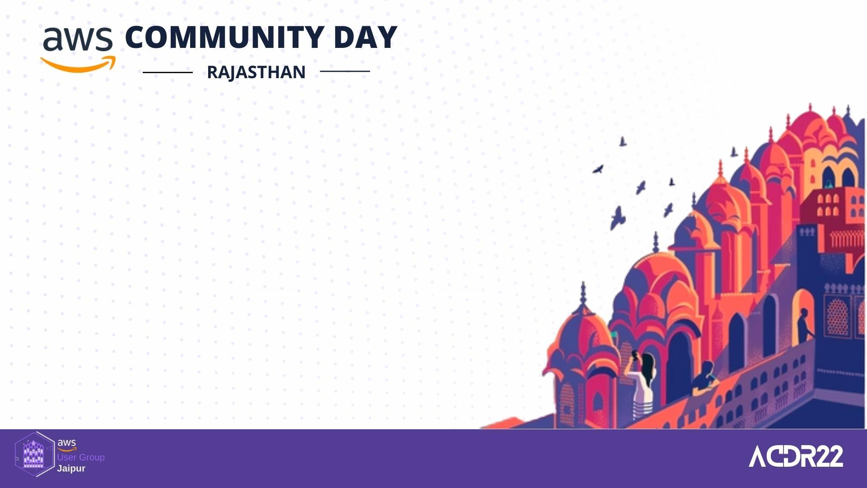
Kickstart your open-source journey !!
SAGAR UTEKAR
VMWare Software India PVT. LTD.

Slide 2

What’s on the Agenda ?
What is Open-Source Software ?
Benefits of Open-Source contribution
Open-Source Myths
Roles in typical Open-Source project
Open-Source communities & events
GSoC mentor and mentee experience
How to chose an Open-Source project
How to get started with Open Source
Do’s and Don'ts

Slide 3
What is Open-Source Software ?
Source code that is made available to public
Decentralized and collaborative
Allow anyone to study, modify, enhance or re-engineer a program’s code and distribute under a permissive license

Slide 4
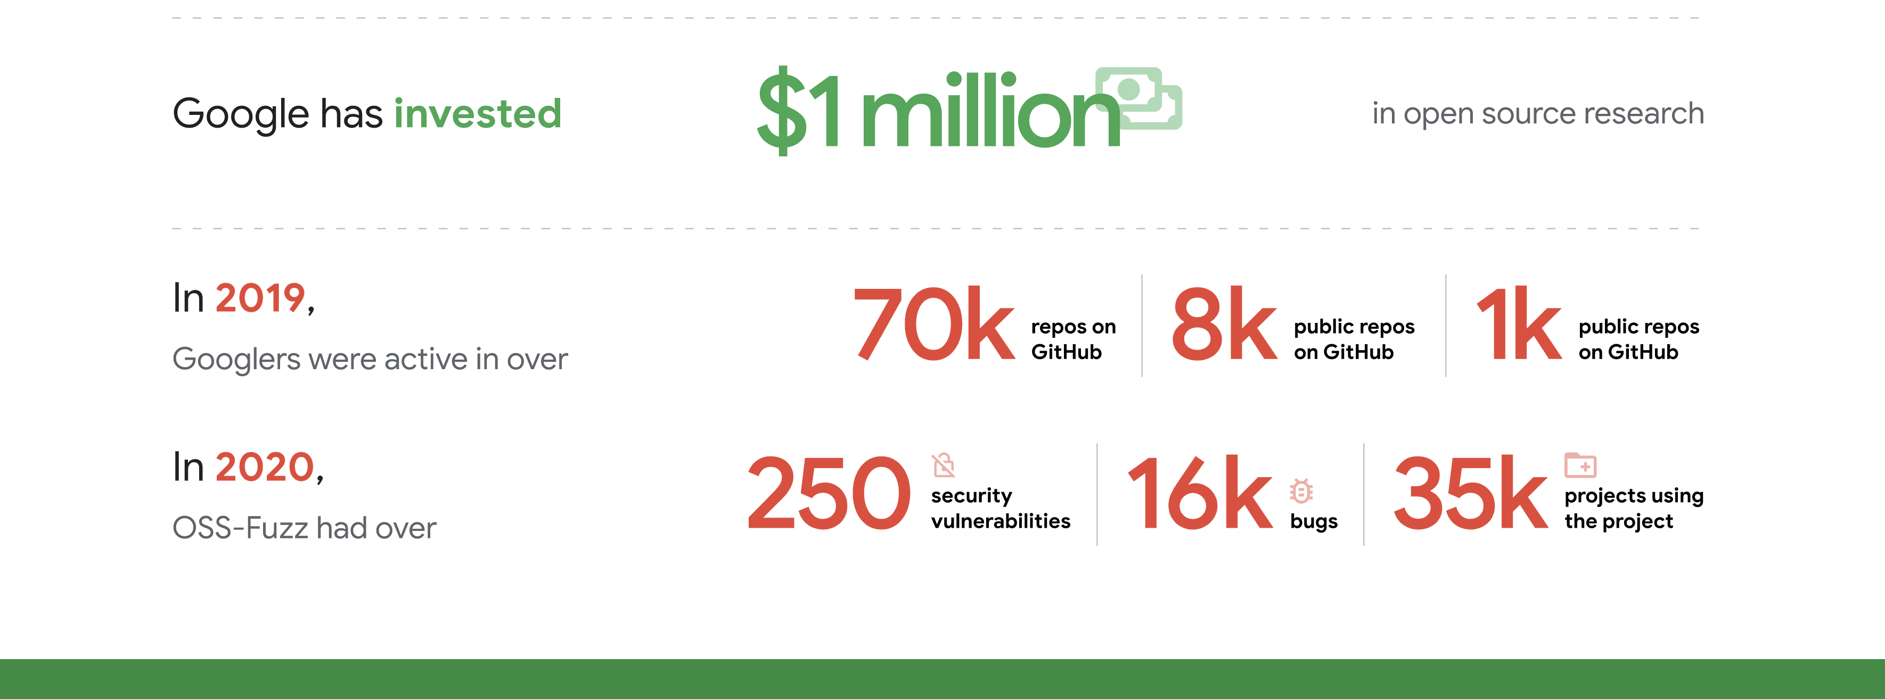
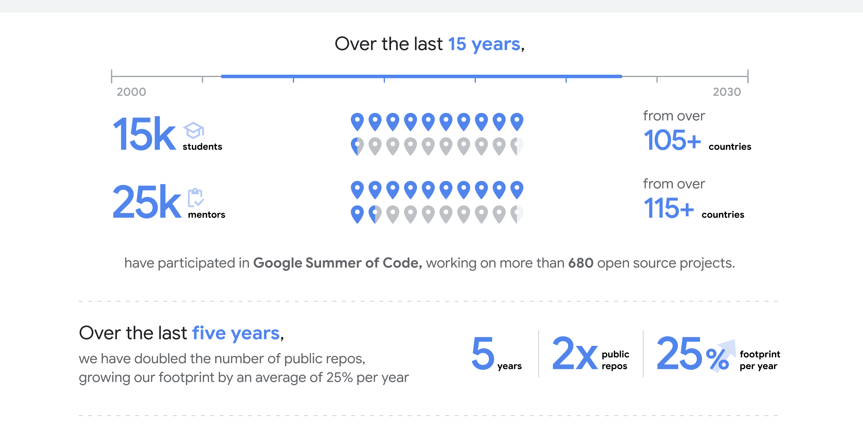
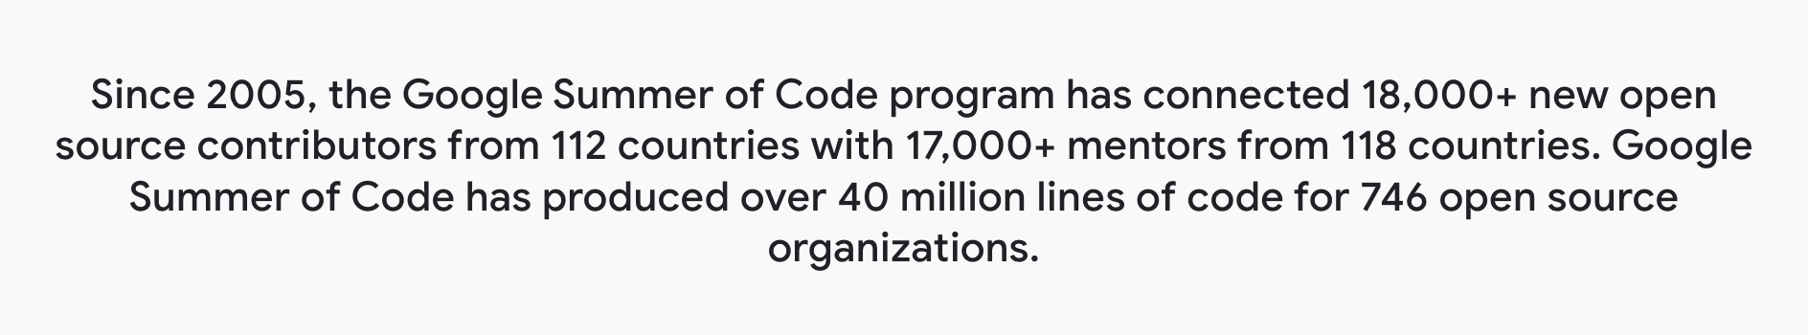
What is Open-Source Software ?

Slide 5
Benefits of Open-Source contribution
Get a chance to up skill yourself
Code, get feedback for contribution, improve, learn
Paying back to the community, global recognition
Make the software better with code and documentation
Meet like-minded people, build networks and communities
Understand the application development and maintenance cycles
Job opportunities
Reading few lines of code is worth more than reading 500 pages of a book, you automatically tend to pickup some great practices while coding.

Slide 6
Open-Source Myths
I don't know to code. Open Source is not my cup of tea.
I know how to code but I'm not familiar with the technology used in this Open-Source project.
I cannot contribute.
Open Source doesn't maintain an enterprise-level standard.
Open-Source Software is always free.
Open Source is for beginners.

Slide 7
ROLES IN TYPICAL OPEN-SOURCE PROJECT
Author/Owner
Maintainers
Contributors
Community Members/Users

Slide 8
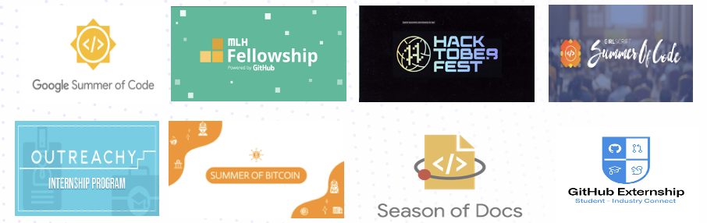
Open-Source communities & events

Slide 9
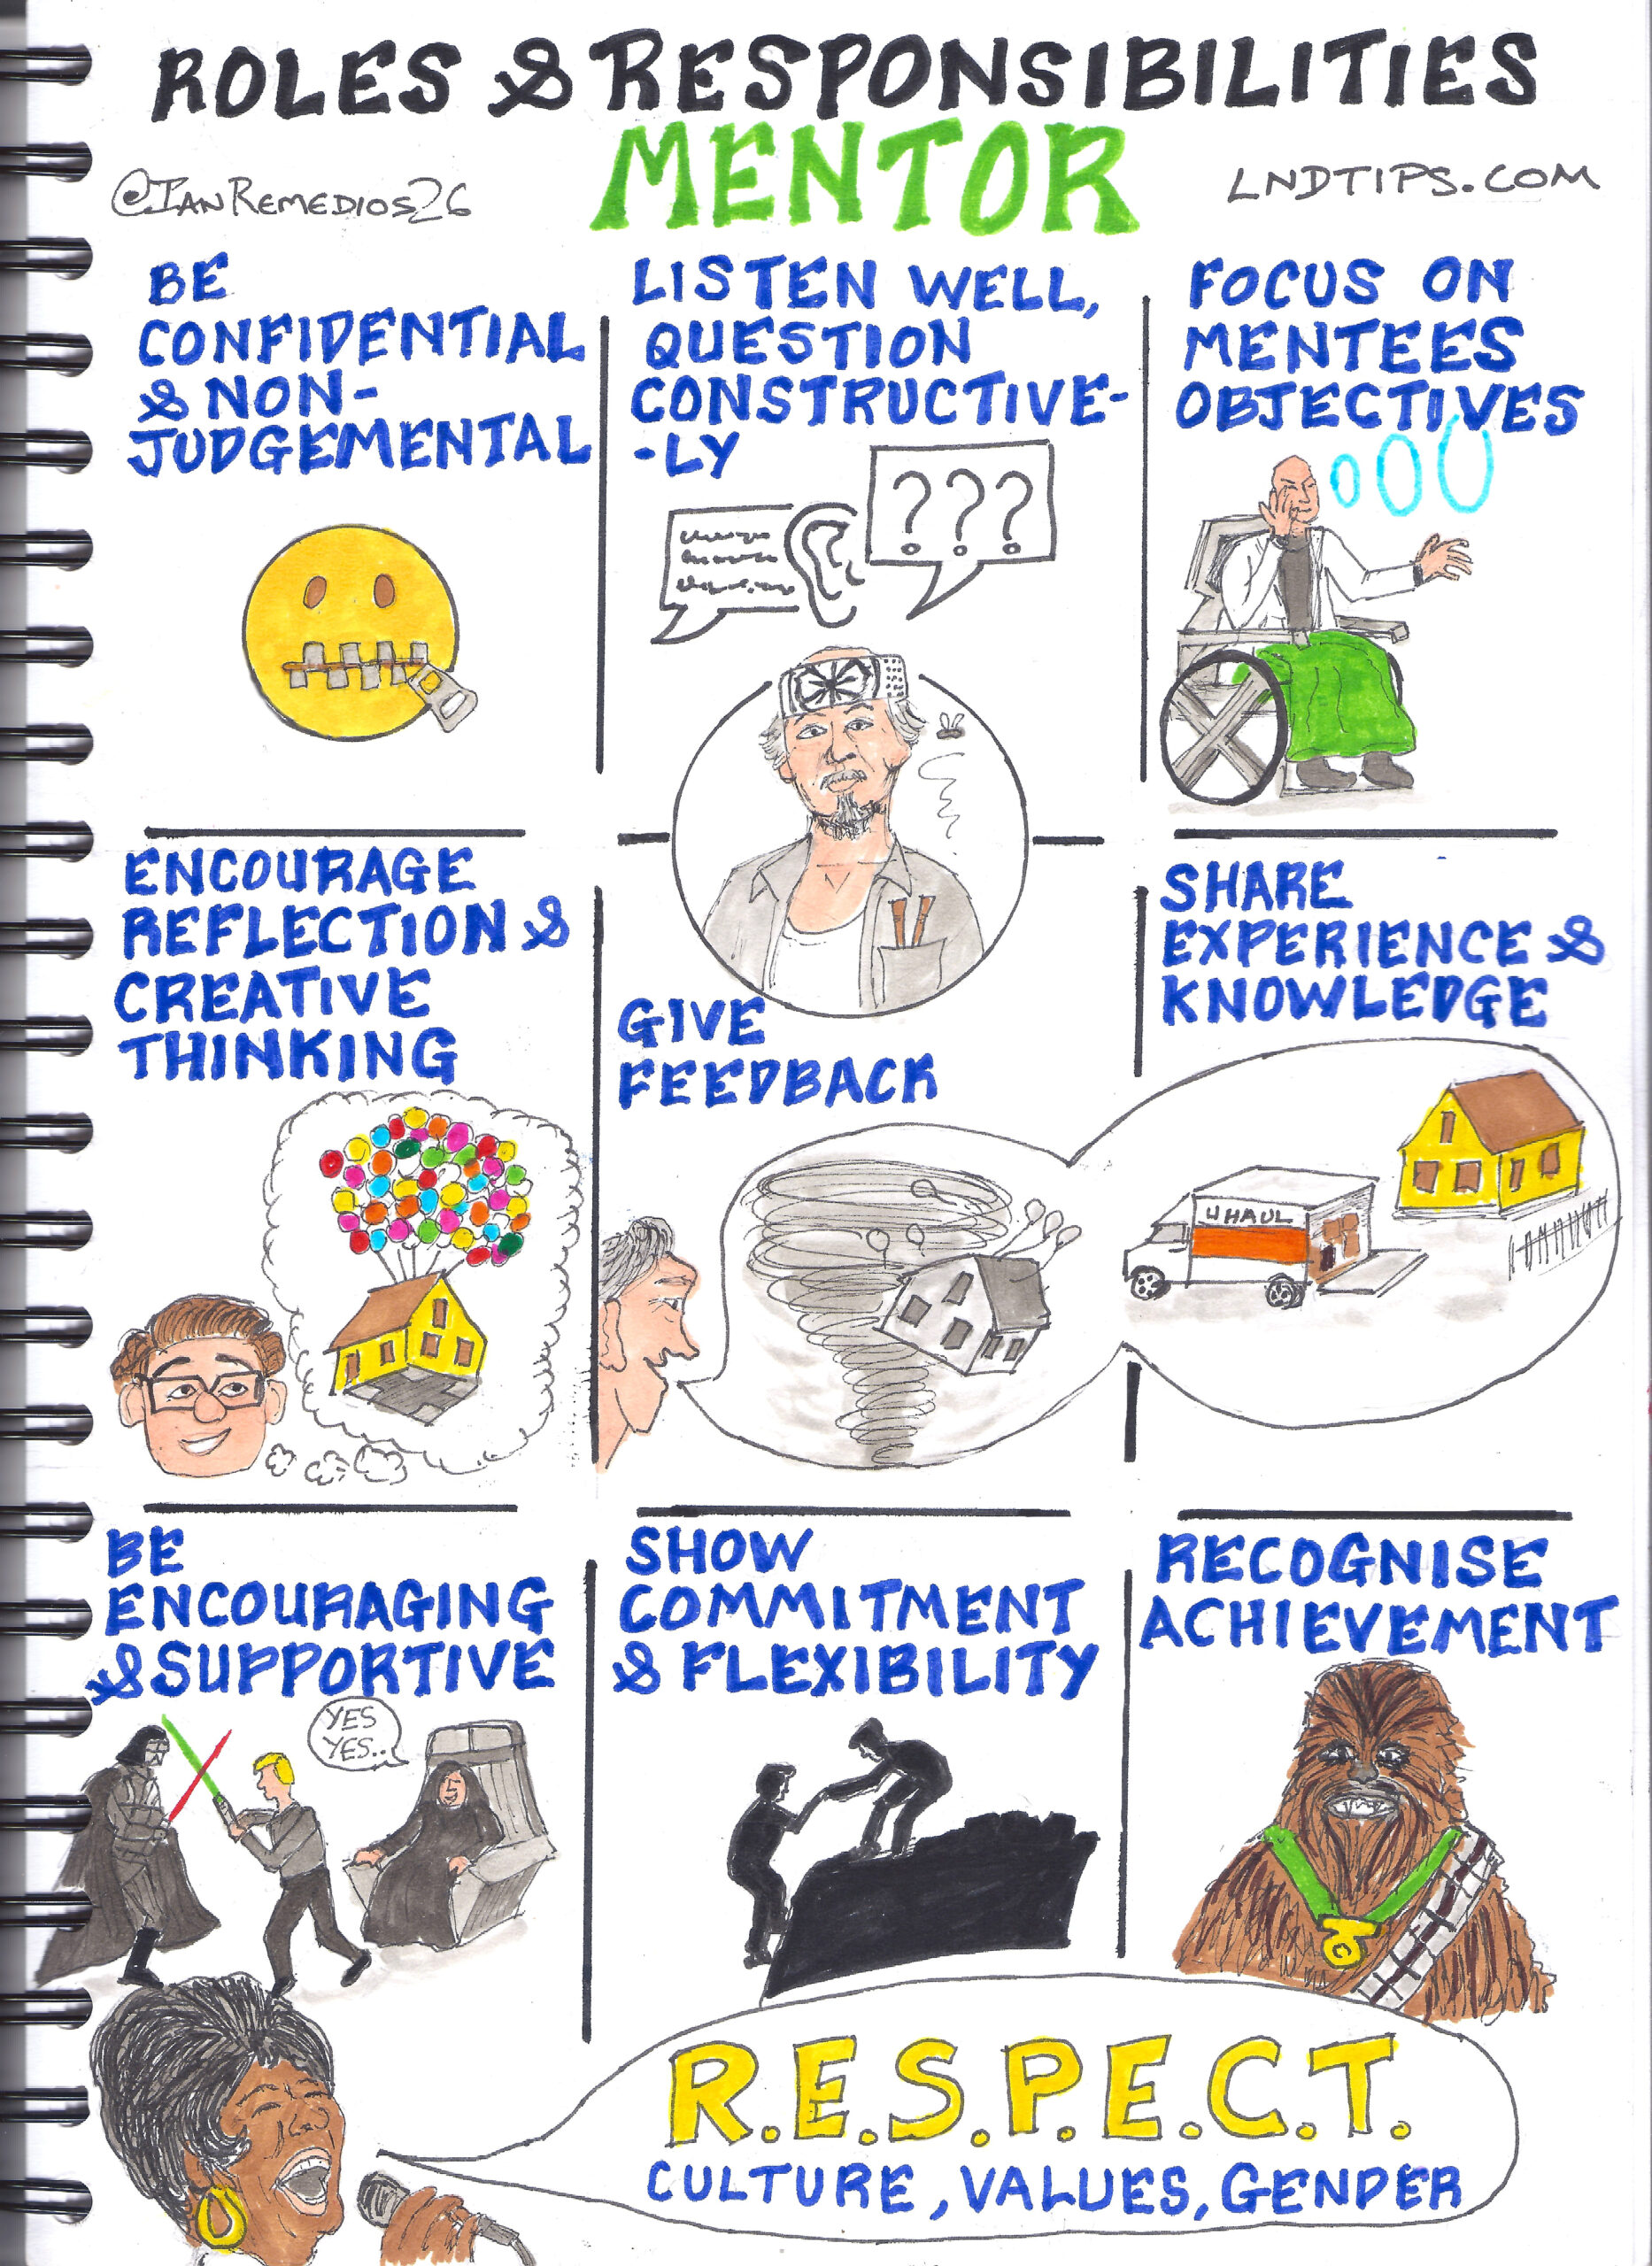
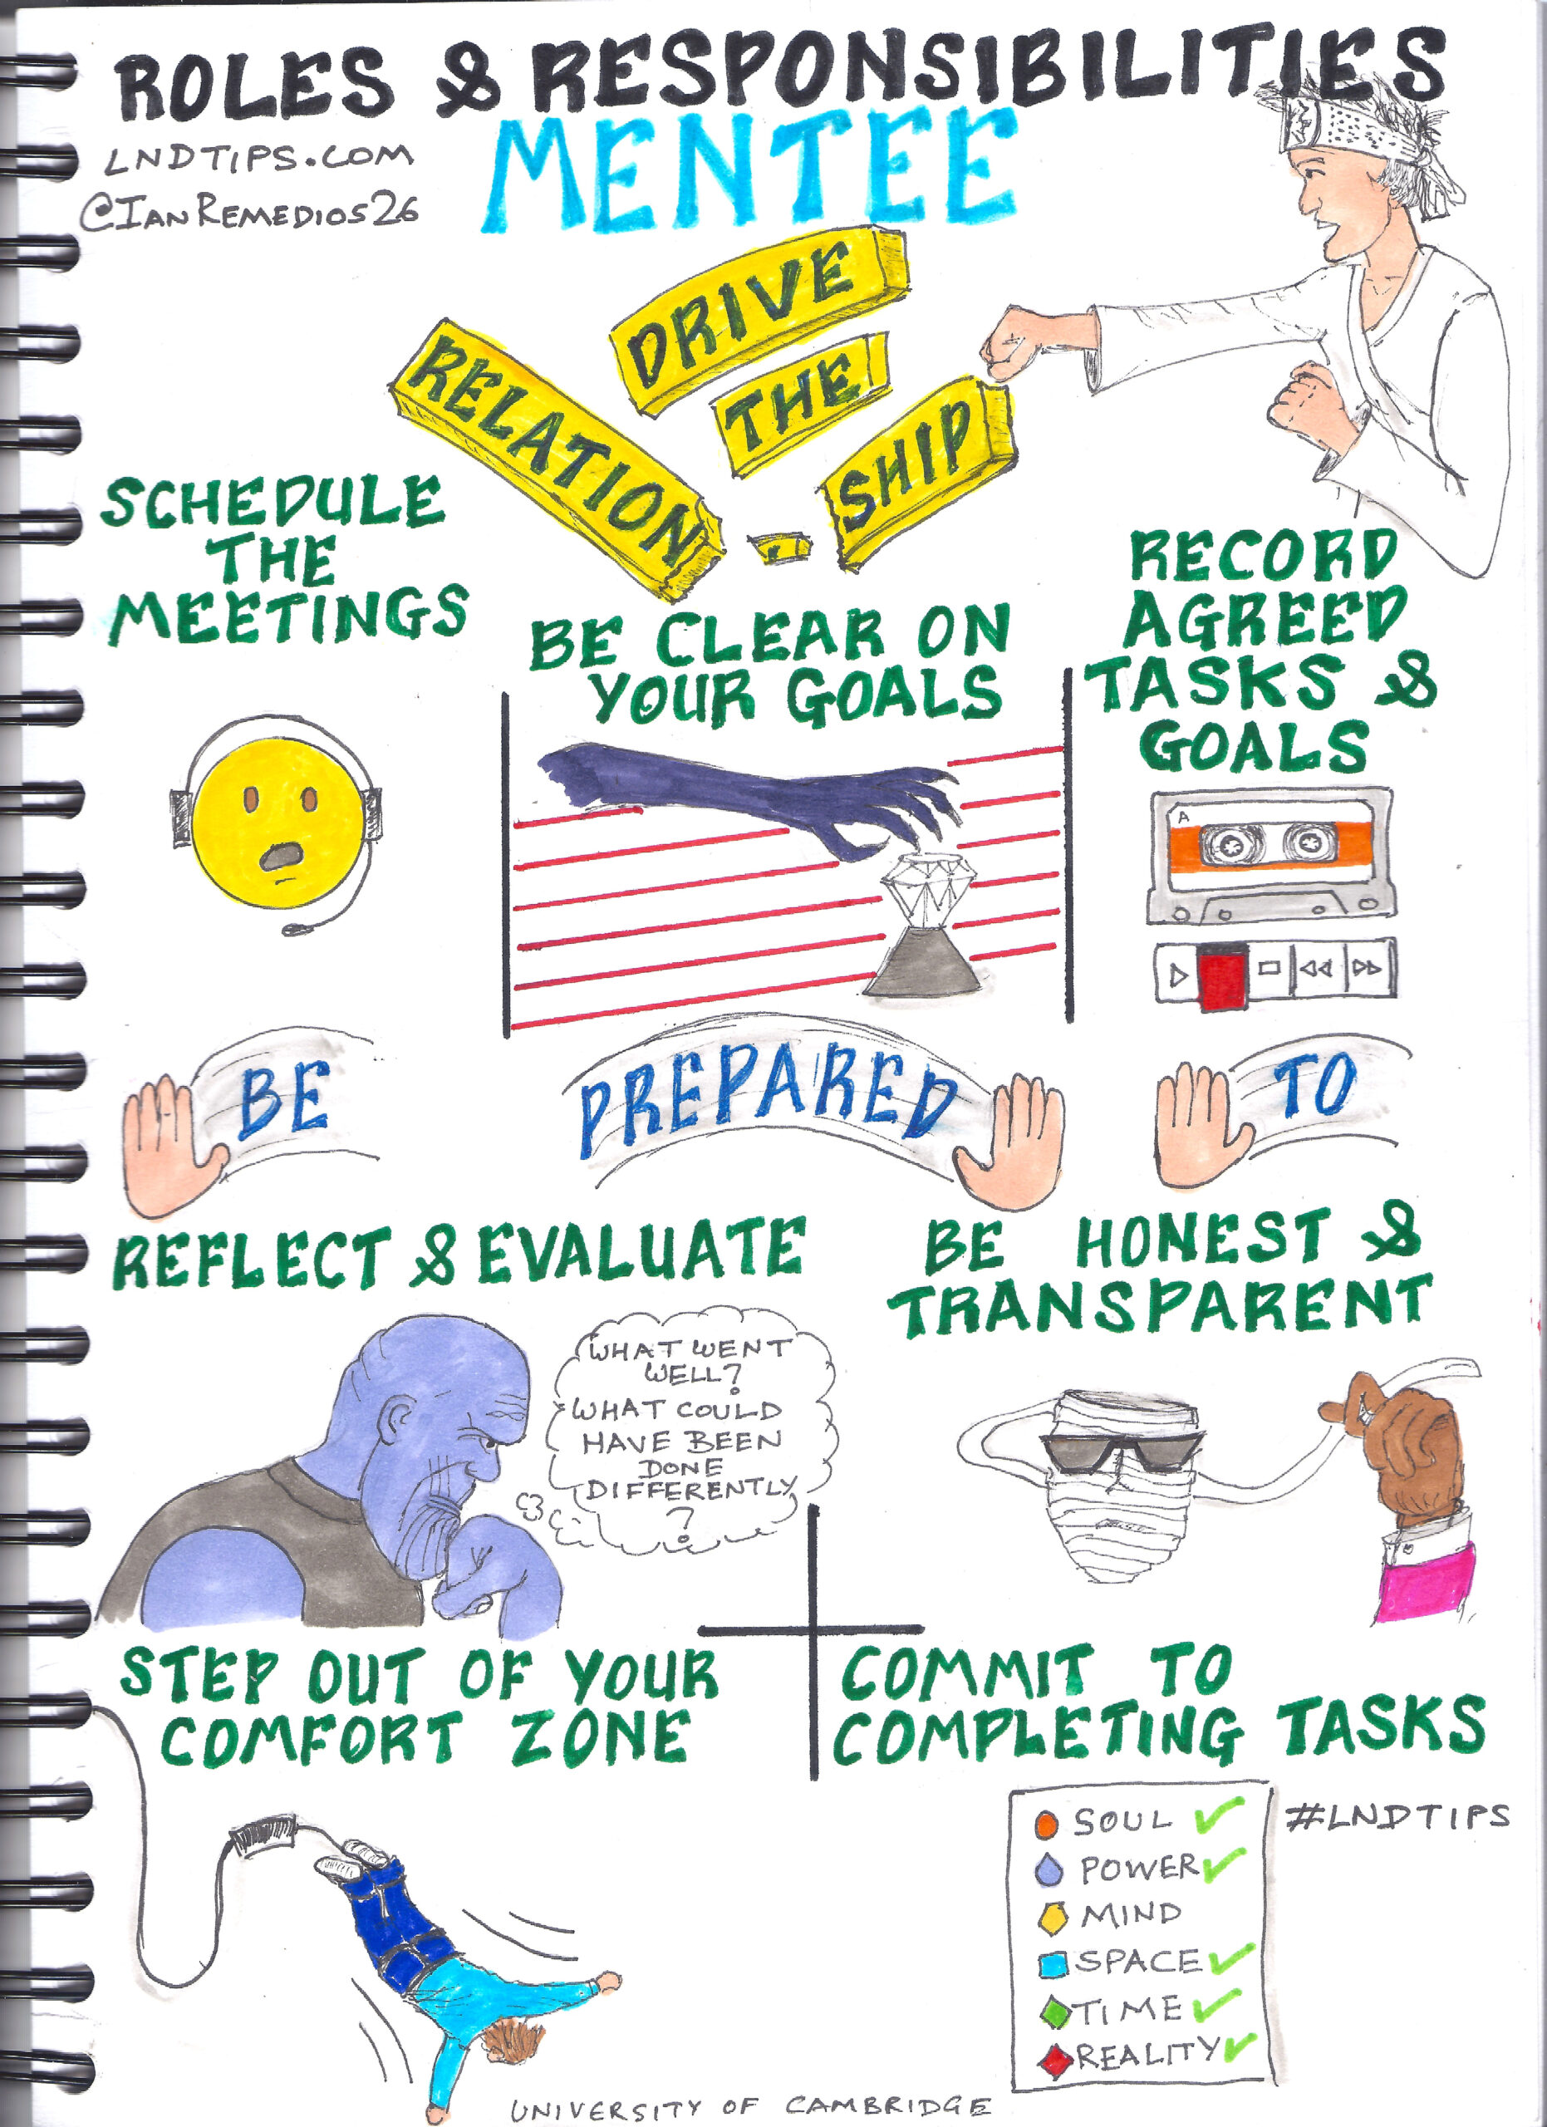
GSOC MENTOR & MENTEE EXPERIENCE

Slide 10
How to chose an open-source project
Project with License file and following Open-Source guidelines
Project, community, Maintainers are active
Availability of Good First Open issues
PRs getting merged actively, Issues getting closed
Active discussions, meetings in community forums
Appreciating environment

Slide 11
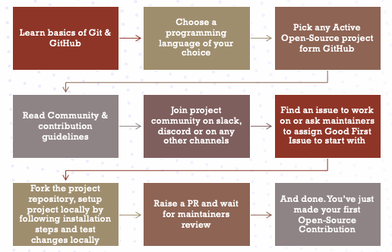
How to get started with open source

Slide 12
Do’s AND DON’TS
Patience is the key
Be Curious, responsive
Build welcoming and helping community
Be humble
Avoid overcommitment and over communication
Appreciate and respect others – They are also Humans
Find a good mentor or group of people
Every contribution matters – irrespective of the lines of code
Documentation, meetups, teaching, maintaining community is also part of Open-Source contribution
Start small to go big
Do proper research – Go through readme.md, contributing.md, recorded sessions and attend meetings
Share your learnings with others
Experiment, try, fail, fail again, fail better

Slide 13
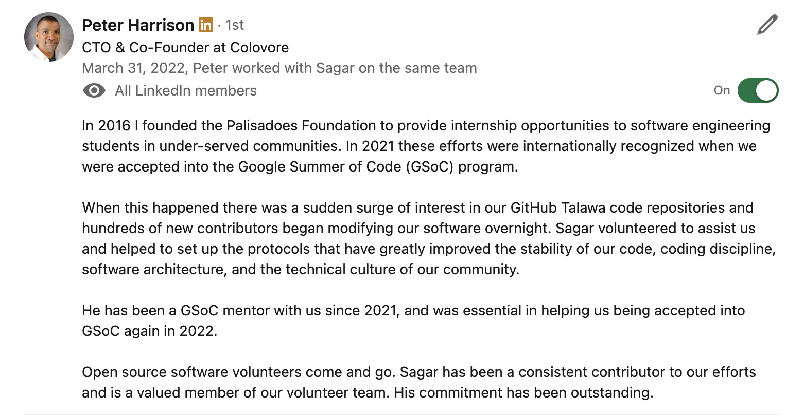
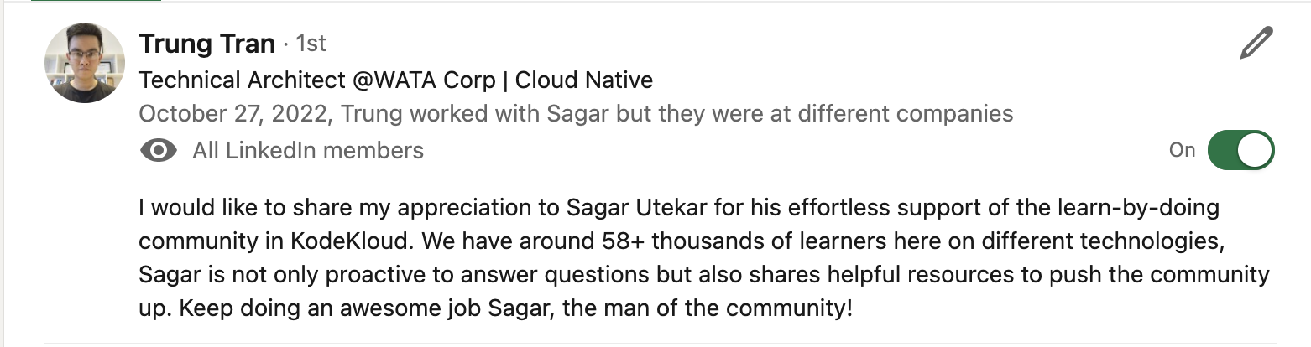
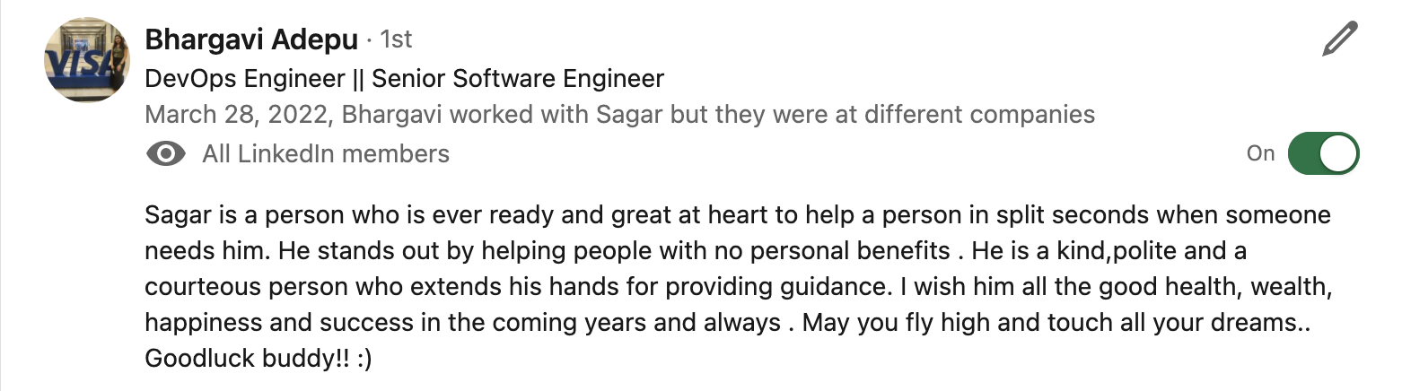
TESTIMONIALS

Slide 14
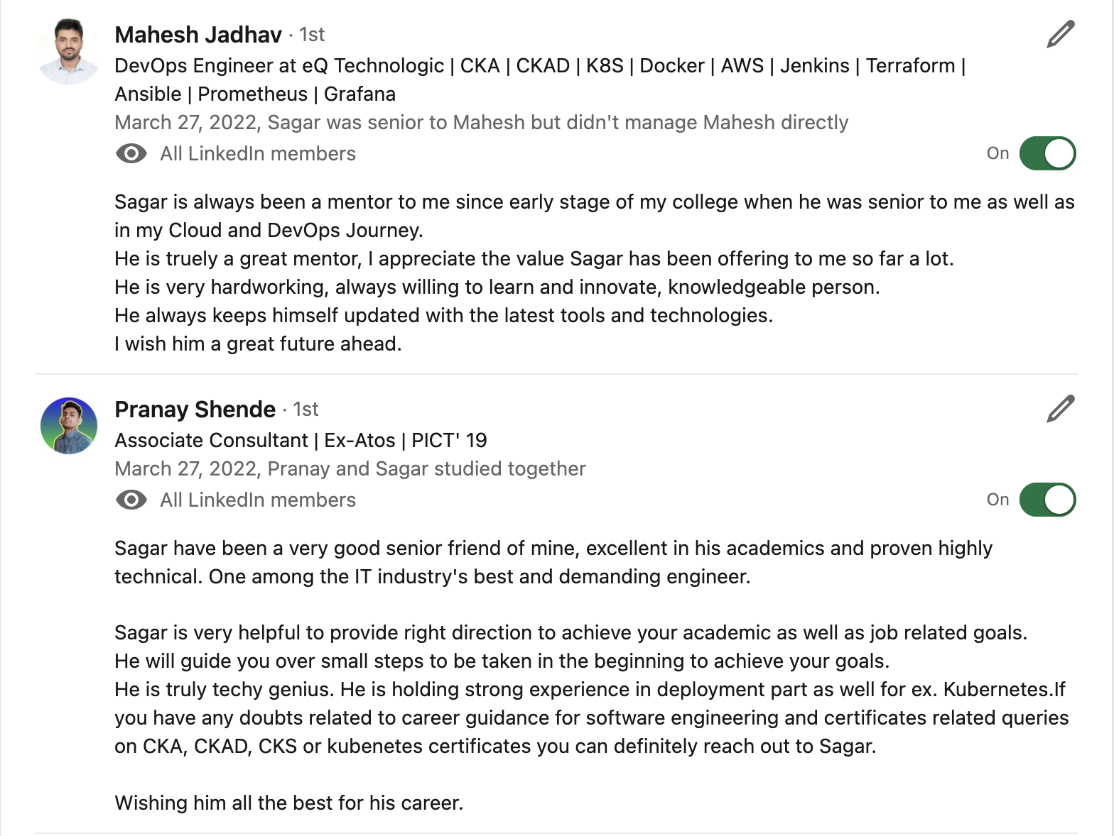
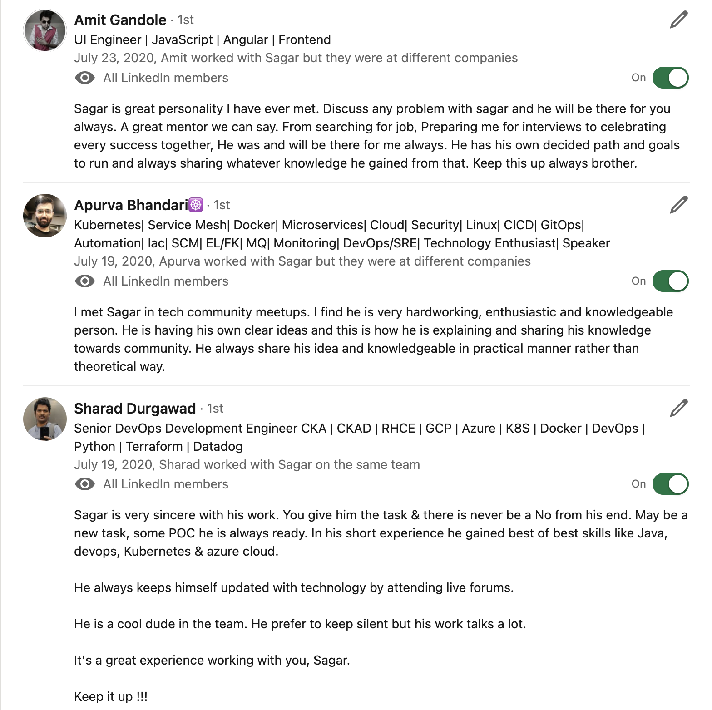
TESTIMONIALS

Slide 15




CONNECT WITH ME
https://www.linkedin.com/in/sagar-utekar/
https://twitter.com/me_sagar_utekar
https://github.com/Sagar2366

